Slide 1

Depression Detection with Speech Analysis (Mobile App)
Tan Hong Ray | Kellie Sim
PS06
Diploma in Engineering Science
Product Design and Development (ESFYP)
Supervisors: Dr Harry Nguyen and Dr Pham The Hanh

Slide 2

Depression makes up 44% of all mental disorders in Singapore

Slide 3

80% of sufferers do not seek help

Slide 4
What is Depression

Slide 5
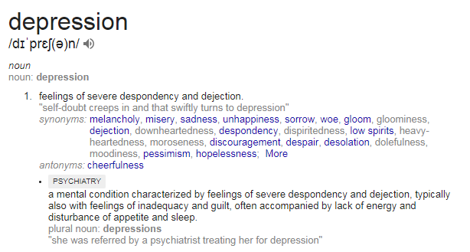

Slide 6
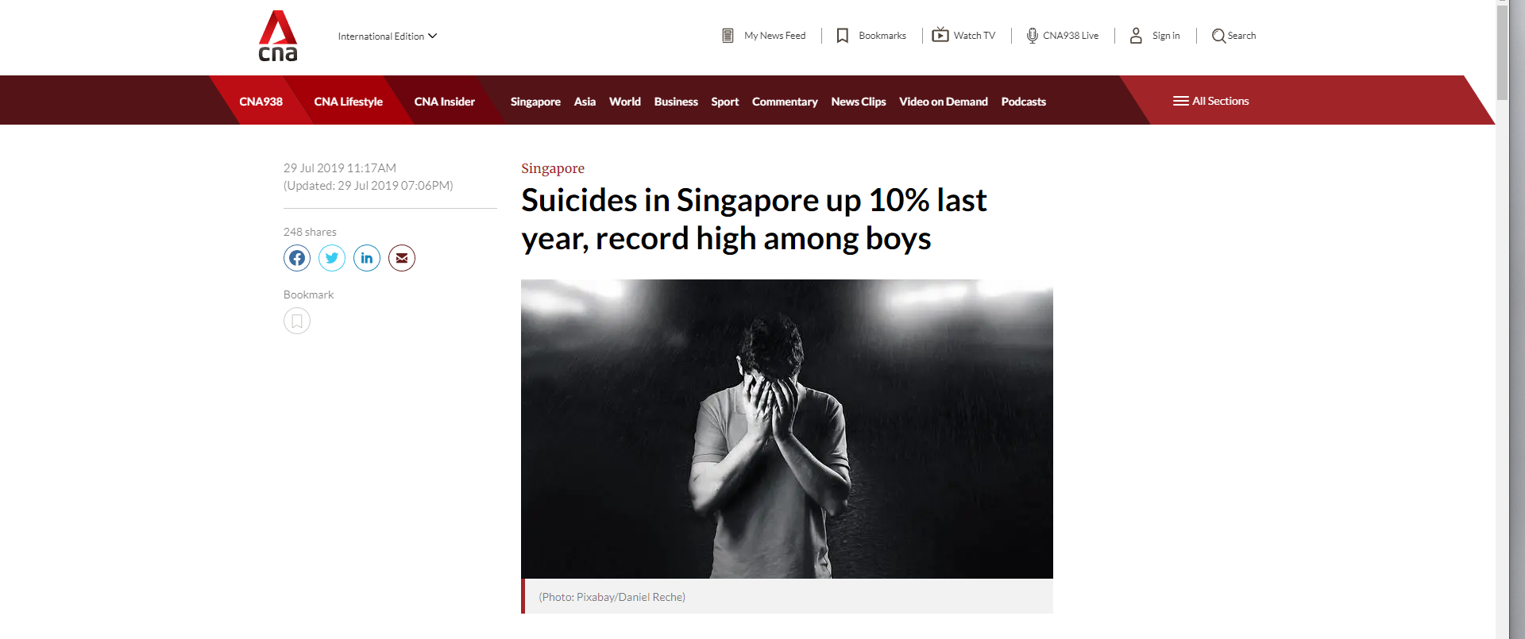

Slide 7
The number of suicides in Singapore rose 10 per cent last year, with suicides among boys aged 10 to 19 at a record high, the Samaritans of Singapore (SOS) said on Monday (Jul 29). There were 397 reported suicides in 2018, compared with 361 the year before. This raised the suicide rate to 8.36 deaths per 100,000 Singapore residents, up from 7.74 in 2017. All age groups, except those aged 60 years and above, recorded an increase in the number of suicides, said the suicide prevention agency. Suicide mortality among youths and males is a "significant societal concern", SOS said, highlighting that for every 10 suicides in 2018, at least seven were by men. A total of 94 people aged between 10 and 29 killed themselves last year, SOS said. Among boys aged between 10 and 19 years old, there were 19 suicides last year – the highest since records began in 1991 and almost triple the seven cases recorded in 2017.

Slide 8
The number of suicides in Singapore rose 10 per cent last year, with suicides among boys aged 10 to 19 at a record high, the Samaritans of Singapore (SOS) said on Monday (Jul 29). There were 397 reported suicides in 2018, compared with 361 the year before. This raised the suicide rate to 8.36 deaths per 100,000 Singapore residents, up from 7.74 in 2017. All age groups, except those aged 60 years and above, recorded an increase in the number of suicides, said the suicide prevention agency. Suicide mortality among youths and males is a "significant societal concern", SOS said, highlighting that for every 10 suicides in 2018, at least seven were by men. A total of 94 people aged between 10 and 29 killed themselves last year, SOS said. Among boys aged between 10 and 19 years old, there were 19 suicides last year – the highest since records began in 1991 and almost triple the seven cases recorded in 2017.

Slide 9
The number of suicides in Singapore rose 10 per cent last year, with suicides among boys aged 10 to 19 at a record high, the Samaritans of Singapore (SOS) said on Monday (Jul 29). There were 397 reported suicides in 2018, compared with 361 the year before. This raised the suicide rate to 8.36 deaths per 100,000 Singapore residents, up from 7.74 in 2017. All age groups, except those aged 60 years and above, recorded an increase in the number of suicides, said the suicide prevention agency. Suicide mortality among youths and males is a "significant societal concern", SOS said, highlighting that for every 10 suicides in 2018, at least seven were by men. A total of 94 people aged between 10 and 29 killed themselves last year, SOS said. Among boys aged between 10 and 19 years old, there were 19 suicides last year – the highest since records began in 1991 and almost triple the seven cases recorded in 2017.

Slide 10
The number of suicides in Singapore rose 10 per cent last year, with suicides among boys aged 10 to 19 at a record high, the Samaritans of Singapore (SOS) said on Monday (Jul 29). There were 397 reported suicides in 2018, compared with 361 the year before. This raised the suicide rate to 8.36 deaths per 100,000 Singapore residents, up from 7.74 in 2017. All age groups, except those aged 60 years and above, recorded an increase in the number of suicides, said the suicide prevention agency. Suicide mortality among youths and males is a "significant societal concern", SOS said, highlighting that for every 10 suicides in 2018, at least seven were by men. A total of 94 people aged between 10 and 29 killed themselves last year, SOS said. Among boys aged between 10 and 19 years old, there were 19 suicides last year – the highest since records began in 1991 and almost triple the seven cases recorded in 2017.

Slide 11
Our Solution
Depression Detection with Speech Analysis

Slide 12
Our Solution
Depression Detection with Speech Analysis

Slide 13

The Application
Information
Provide quantitative information that complements existing methods of detecting depression
Help
Help people affected by depression on a day to day basis
Reduce
Reduce cost incurred due to prolonged and expensive medical treatments
Create
Create an easy and accessible way to detect depression

Slide 14




Slide 15
Application on phone sends a .wav file to the server

Slide 16
Server receives the .wav file

Slide 17
Audio data in .wav file is denoised

Slide 18
.wav file is converted into a spectrogram

Slide 19
Spectrogram is fed into CNN model and prediction is returned

Slide 20
Application receives and displays prediction on screen

Slide 21


How It Works

Slide 22

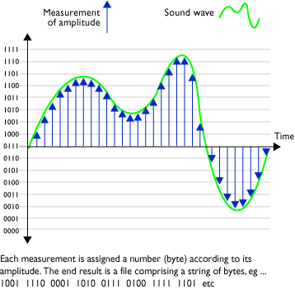
Audio Recording
Records PCM data into .wav file
Sample rate used: 8000Hz (8000 samples per second) and 16 bit per sample
Number of channels used: 1 (Mono)
Instantaneous amplitude at each sampling was used in our audio visualisation

Slide 23


Backend Server
Calls RESTful APIs from a backend server hosted on our laptop
API takes in .wav file, and returns prediction of audio
When server runs, model generated will be loaded
Our prediction – a JSONObject (key, value pair of data) will be returned to the application

Slide 24

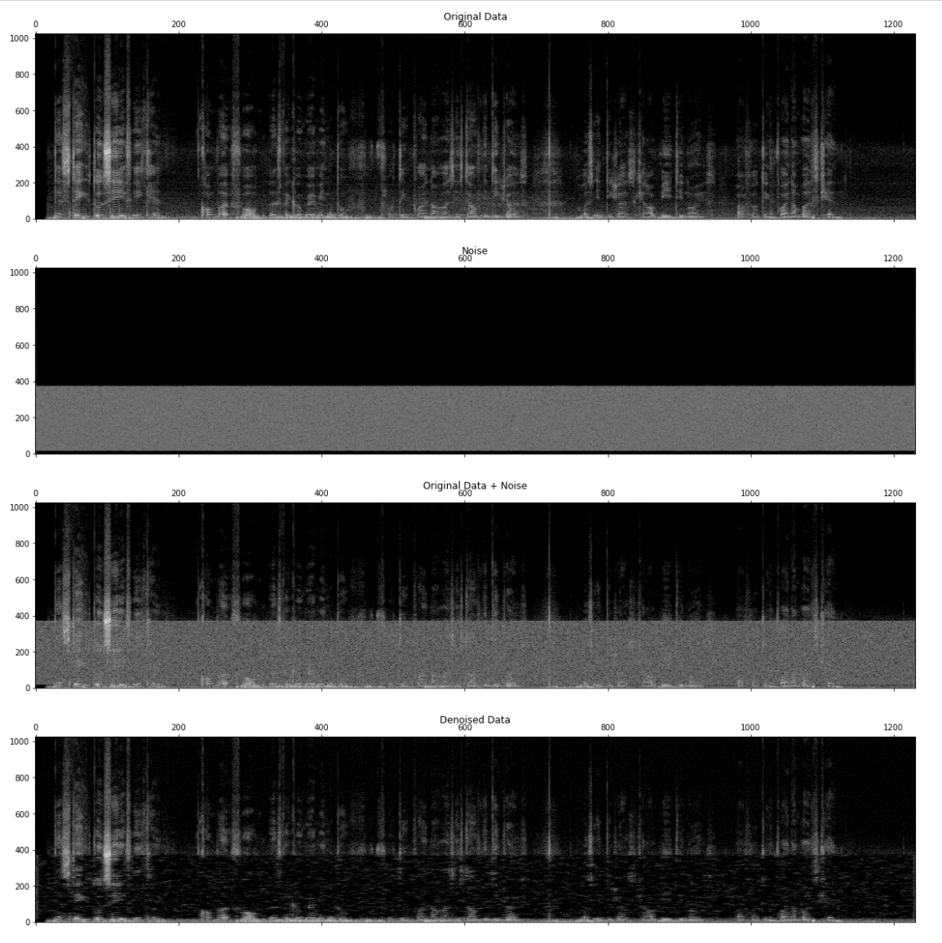
Audio Denoising
Uses Spectral Gating in Python
The algorithm requires two inputs:
A noise audio clip containing prototypical noise of the audio clip
A signal audio clip containing the signal and the noise intended to be removed

Slide 25
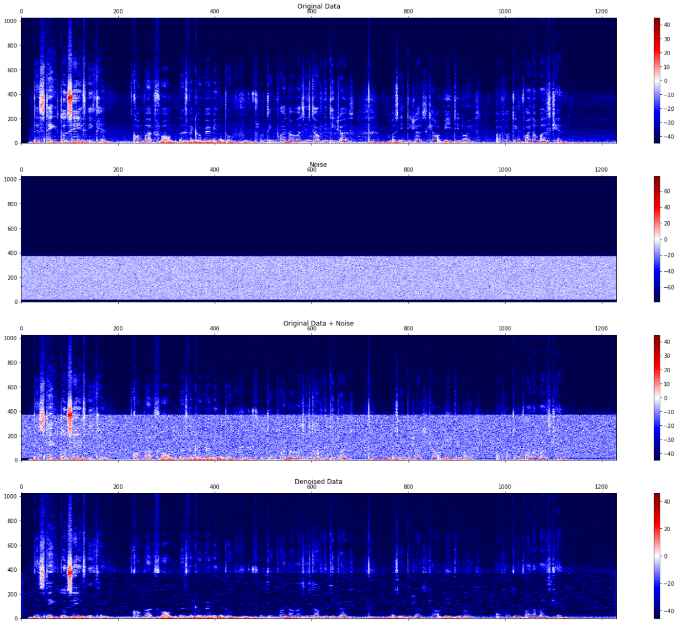
Audio Denoising
Steps of Algorithm:
An FFT is calculated over the noise audio clip
Statistics are calculated over FFT of the noise (in frequency)
A threshold is calculated based upon the statistics of the noise (and the desired sensitivity of the algorithm)
An FFT is calculated over the signal
A mask is determined by comparing the signal FFT to the threshold
The mask is smoothed with a filter over frequency and time
The mask is applied to the FFT of the signal, and is inverted

Slide 26

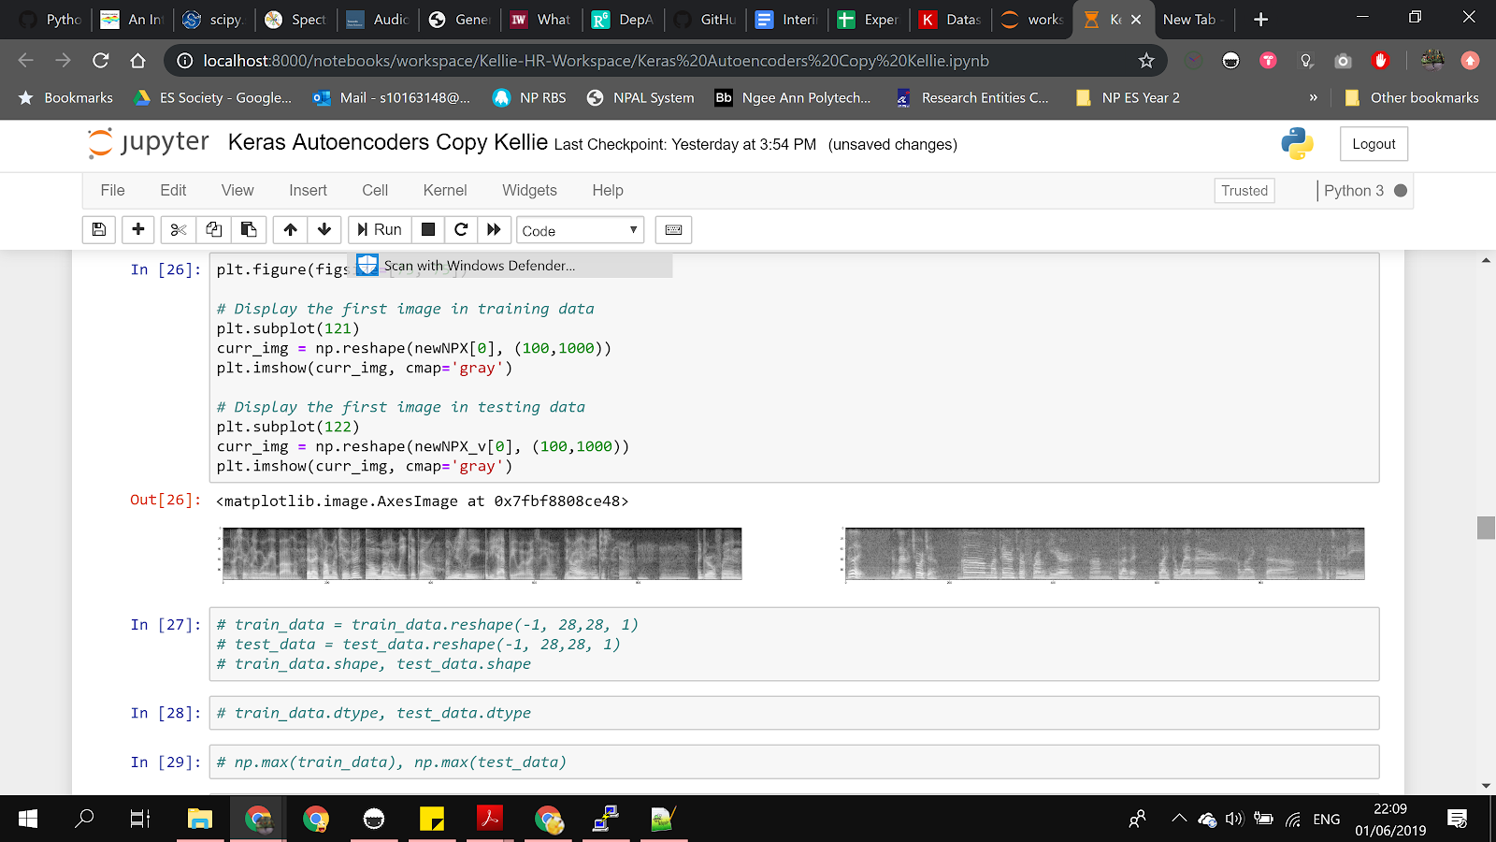
Spectrogram Generation
A spectrogram is a record produced by a sound spectrograph with time shown along the horizontal axis, frequency shown along the vertical axis, and intensity indicated by varying shades of darkness of the pattern
Spectrograms are used as it contains a high level of detail from the audio file
Grayscale spectrograms are used so as to reduce the computational demand
.wav file

Slide 27
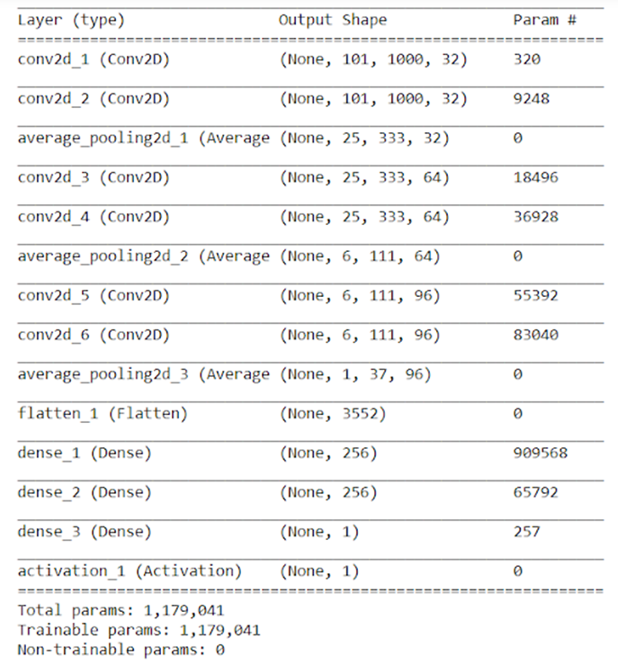
Convolutional Neural Network

Slide 28

Convolution

Slide 29
Convolution
Preserves spatial relationship between pixels by learning image features using small squares of input data
Extracts features from input
Size of convolved feature is controlled by: depth (number of filters), stride (number of pixels by which filter is slid), zero-padding (around border)
Element wise multiplication and addition
Activation layer at the end

Slide 30
Dense/Fully Connected

Slide 31
Dense/Fully Connected
Regular layer of neurons in a neural network
Each neuron receives input from all the neurons in the previous layer
Represents matrix vector multiplication
Every input is connected to every output by a weight

Slide 32
Flatten

Slide 33
Flatten
Remove all dimensions except for one
Reshapes tensor to have a shape that is equal to the number of elements contained in it

Slide 34
Average Pooling

Slide 35
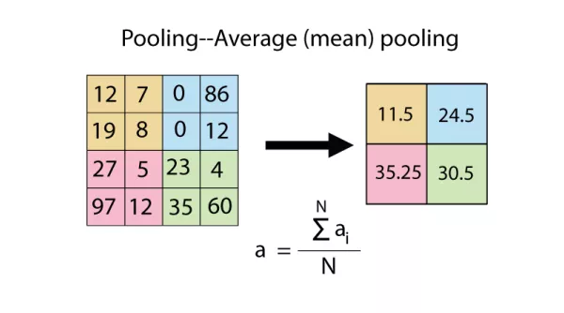
Average Pooling

Slide 36
Average Pooling
Reduces dimensionality of each feature map but retains most important information
Makes the network invariant to small transformations, distortions and translations in the input image
Allows us to detect objects in an image no matter where they are located

Slide 37
Activation

Slide 38
Activation
Decides whether a neuron should be activated by calculating the weighted sum and further adding bias with it
Introduces non-linearity into the output of a neuron
Sigmoid function is used so that output will always be within 0 and 1

Slide 39
Activation
Decides whether a neuron should be activated by calculating the weighted sum and further adding bias with it
Introduces non-linearity into the output of a neuron
Sigmoid function is used so that output will always be within 0 and 1

Slide 40
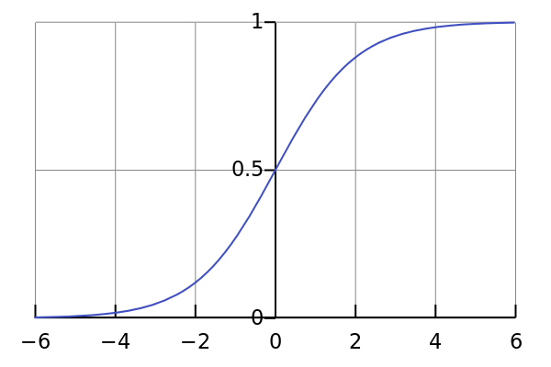
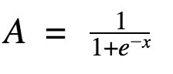
Activation

Slide 41
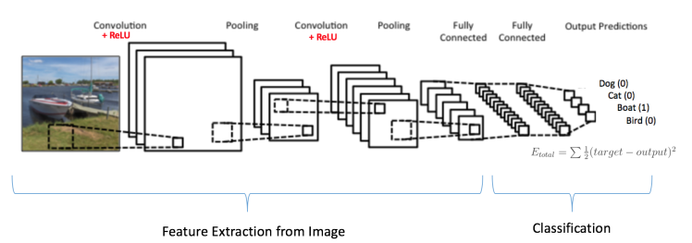
Summary

Slide 42
However, with this, our accuracy was
60%

Slide 43

Optimisation

Slide 44





Optimisation
Autoencoders
k-Fold Cross Validation
Generative Adversarial Networks
Spectral Gating

Slide 45
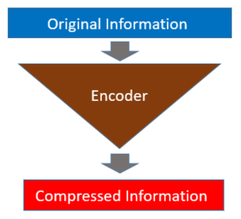
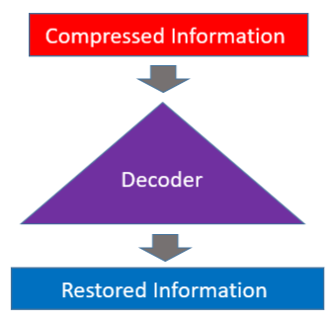
Autoencoders
Encoder
Decoder

Slide 46
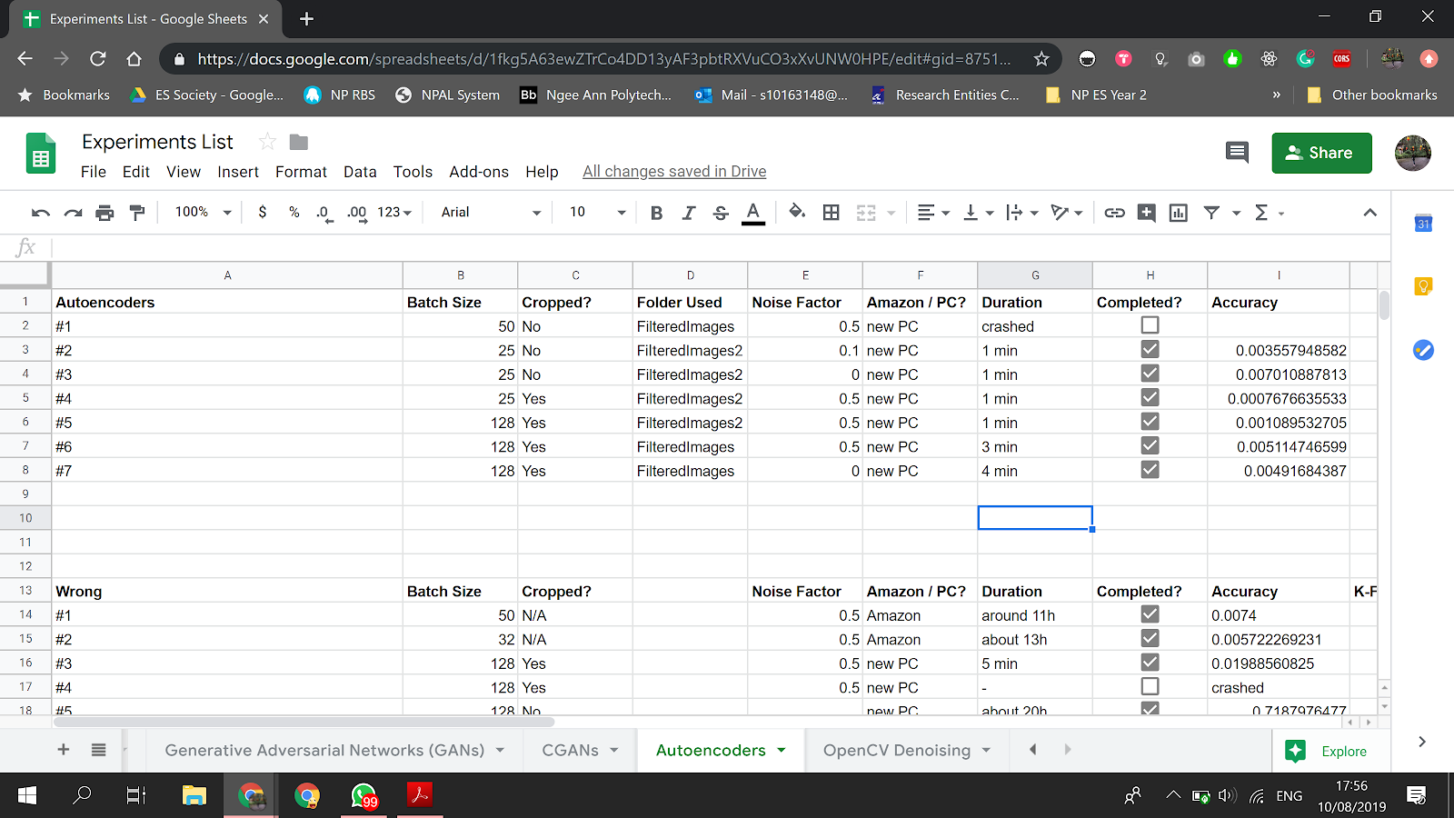
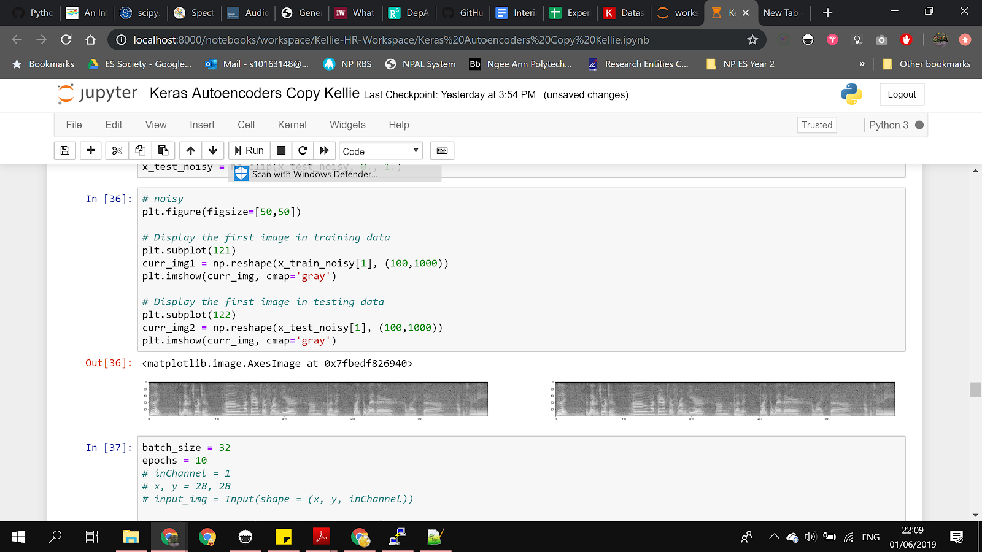
Autoencoders

Slide 47
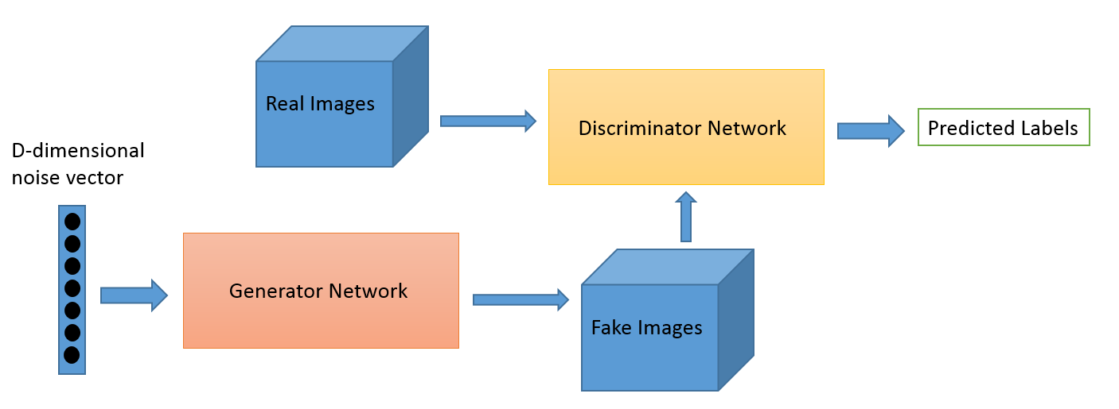
Generative Adversarial Networks (GAN)

Slide 48
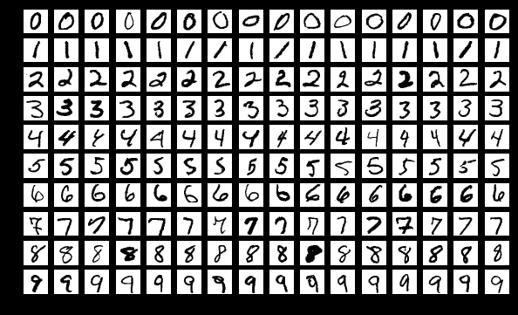
Generative Adversarial Networks (GAN)
MNIST Dataset

Slide 49
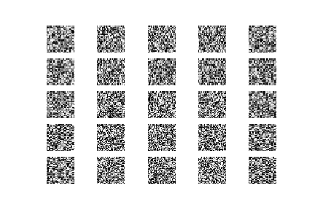
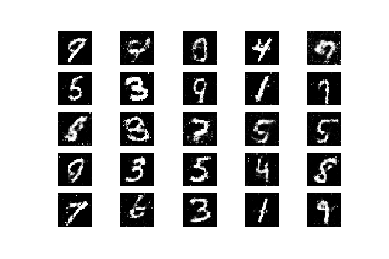
Generative Adversarial Networks (GAN)
Outputs from generator
1st epoch
20th epoch

Slide 50
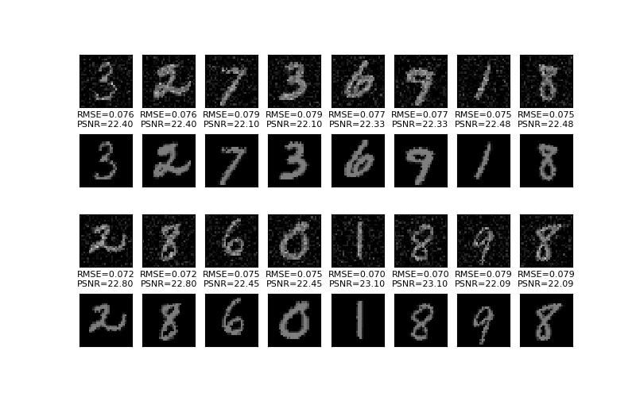
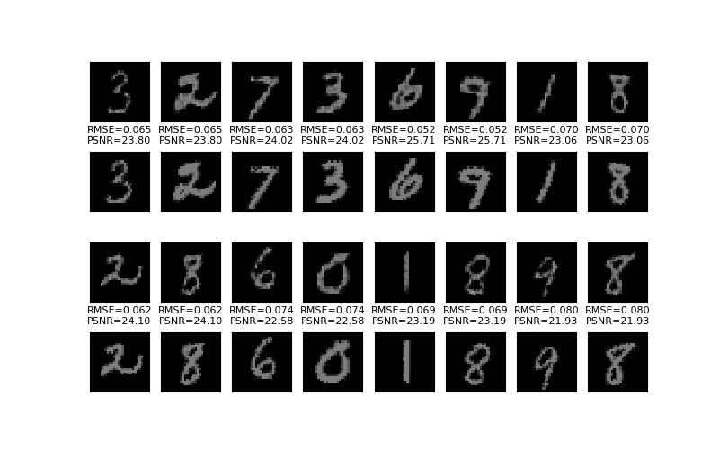
Conditional Generative Adversarial Networks
Outputs from generator
1st epoch
20th epoch
Notes:
Image generation can be conditional on a class label, if available, allowing the targeted generated of images of a given type. This means that when the trained generator model is used as a standalone model to generate images in the domain, images of a given type, or class label, can be generated

Slide 51
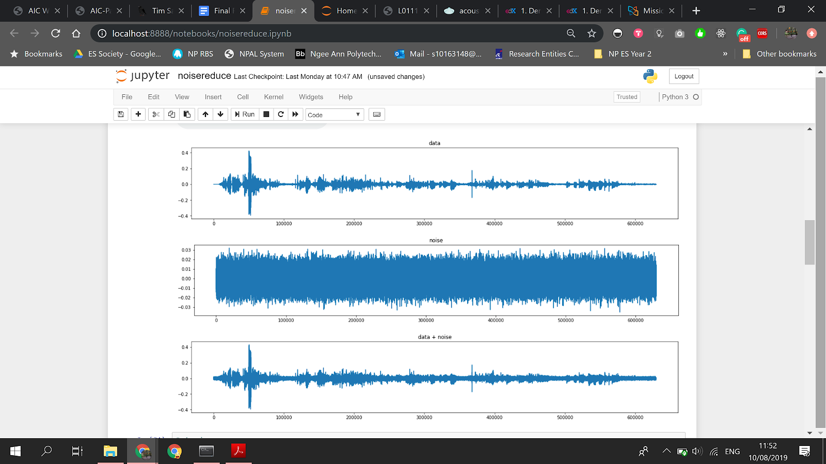
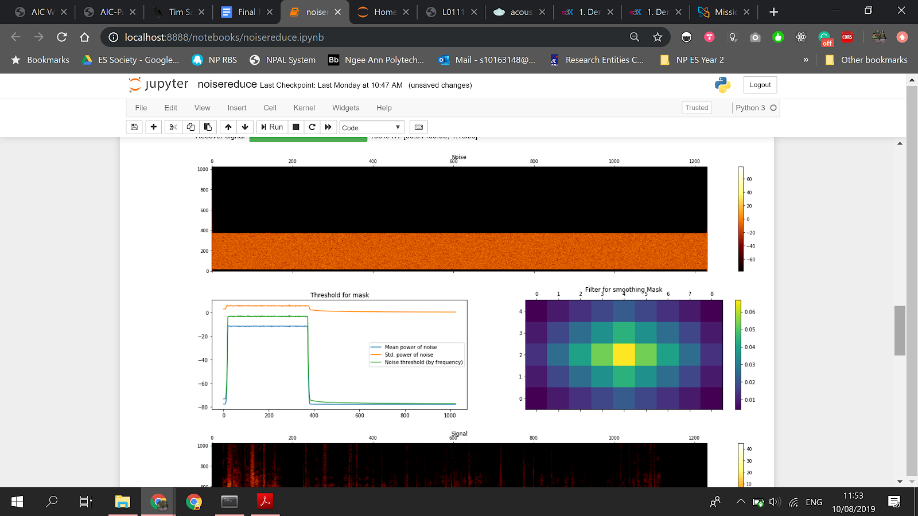
Spectral Gating

Slide 52
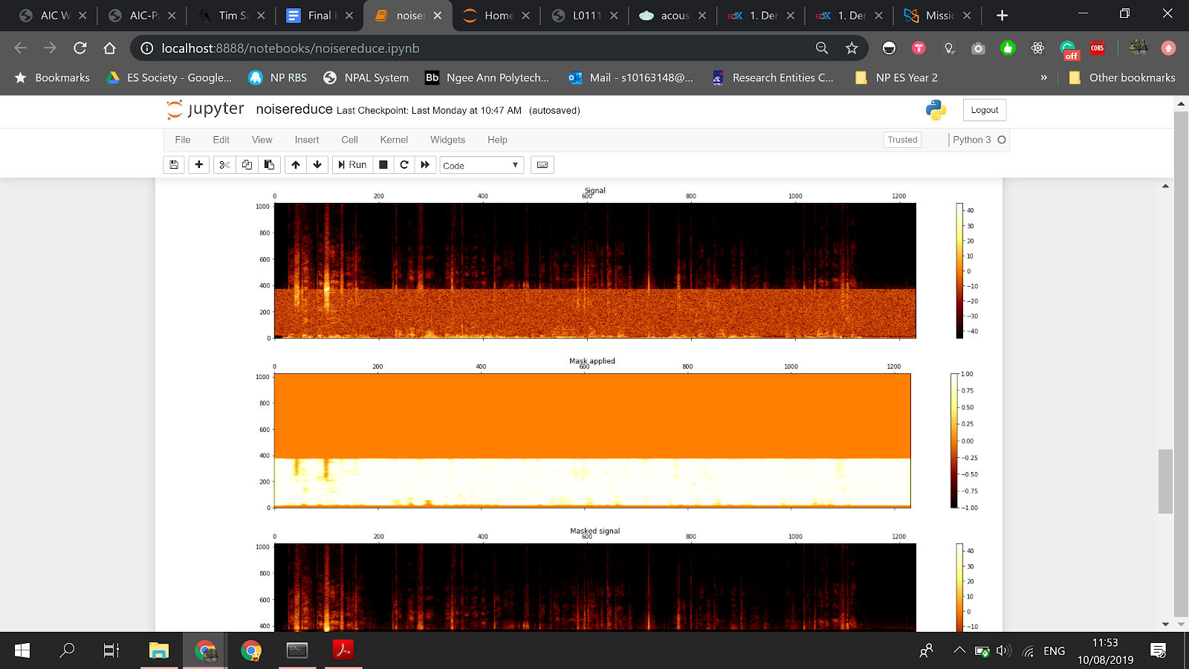
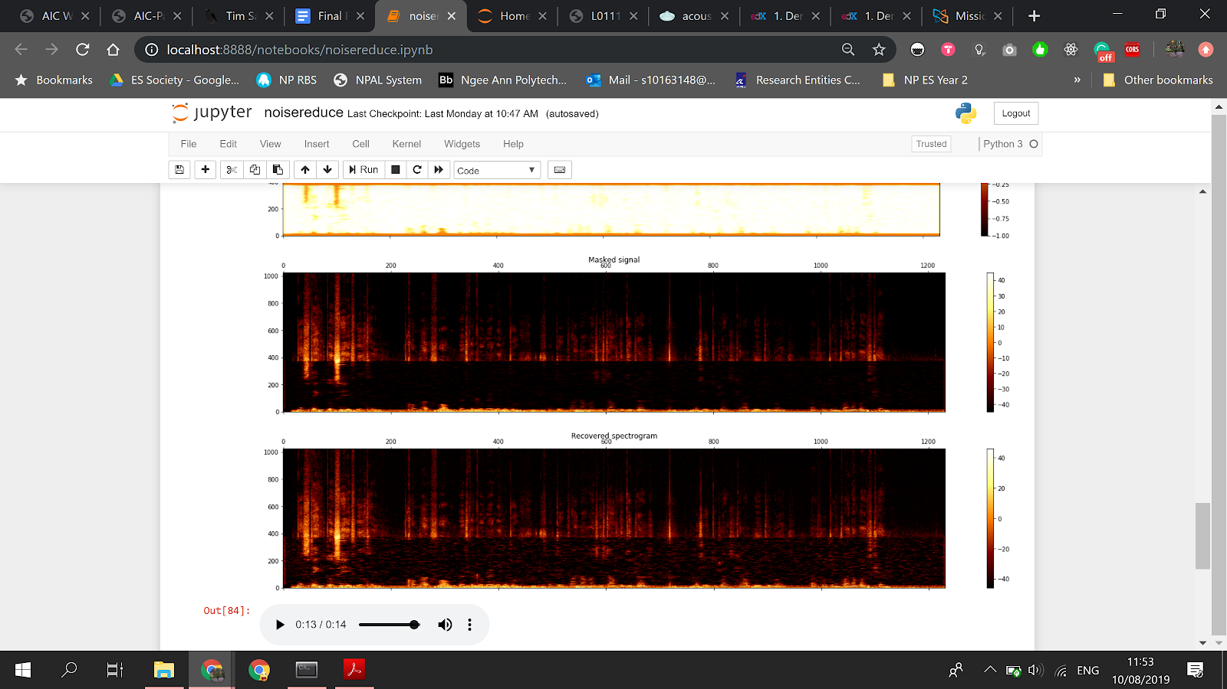
Spectral Gating

Slide 53
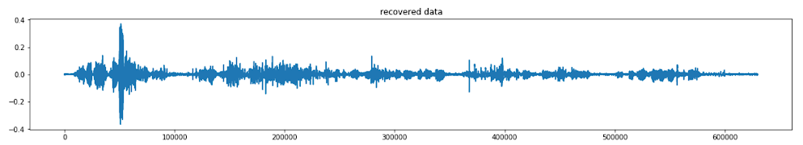
Spectral Gating

Slide 54
K-Fold Cross Validation
Training set
Test set

Slide 55
K-Fold Cross Validation
Training set
Test set

Slide 56
K-Fold Cross Validation
Training set
Test set

Slide 57
K-Fold Cross Validation
Training set
Test set

Slide 58
K-Fold Cross Validation
Training set
Test set

Slide 59
K-Fold Cross Validation
Training set
Test set

Slide 60
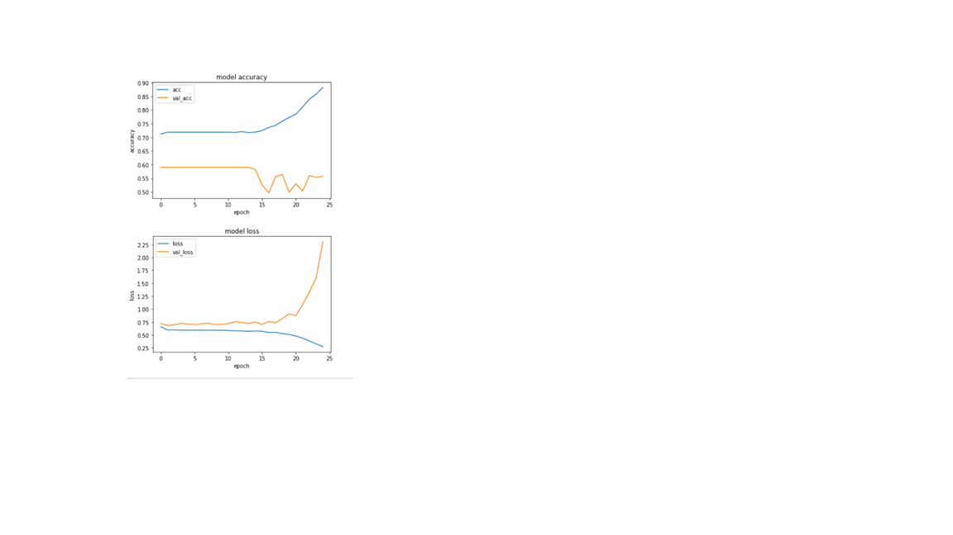
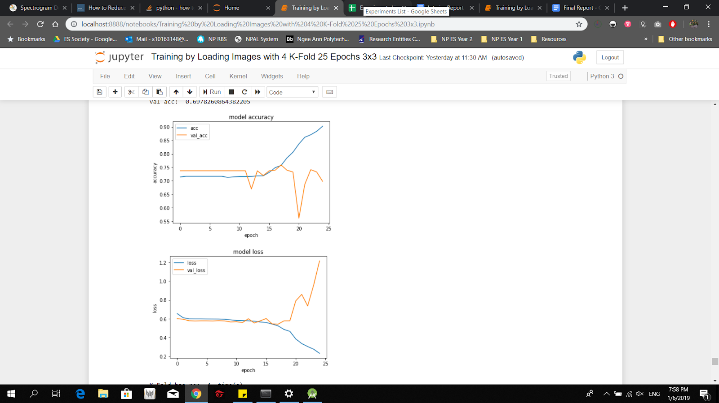
K-Fold Cross Validation
Without K-Fold
With K-Fold

Slide 61
K-Fold Cross Validation

Slide 62
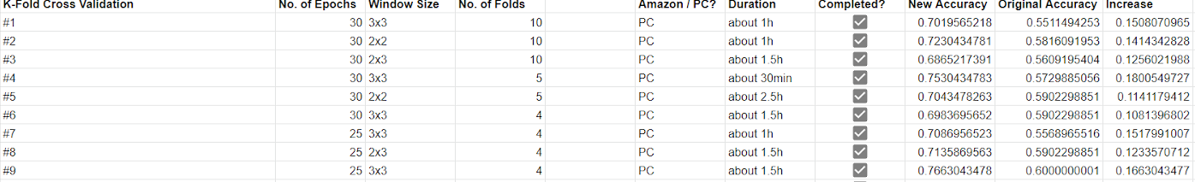
K-Fold Cross Validation

Slide 63


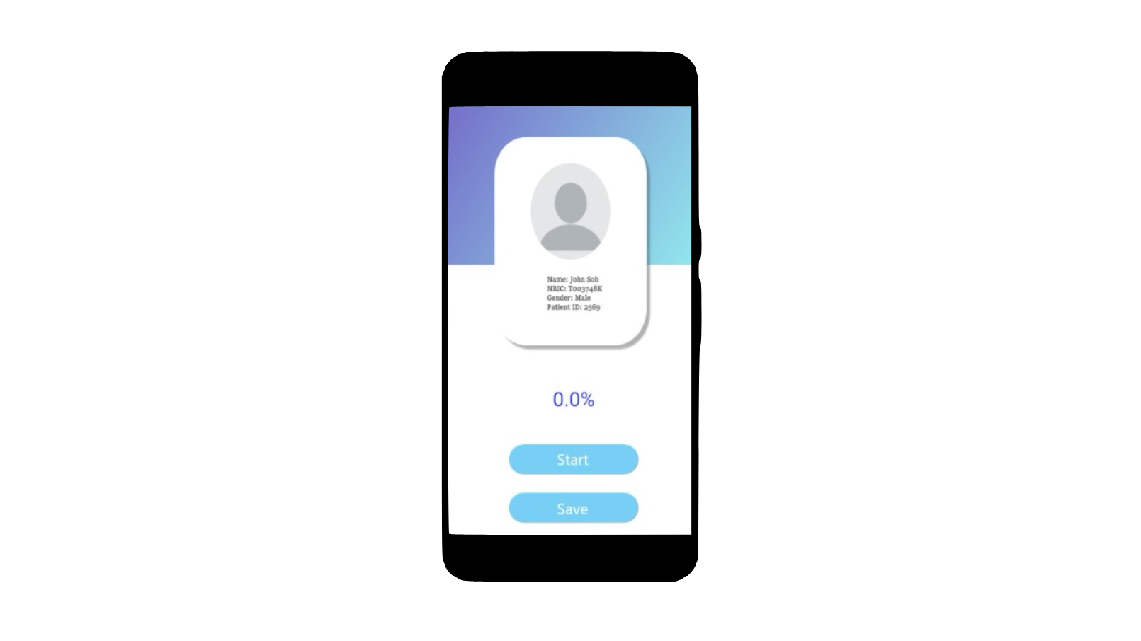
Demonstration

Slide 64
Demonstration

Slide 65
Demonstration

Slide 66
Demonstration

Slide 67
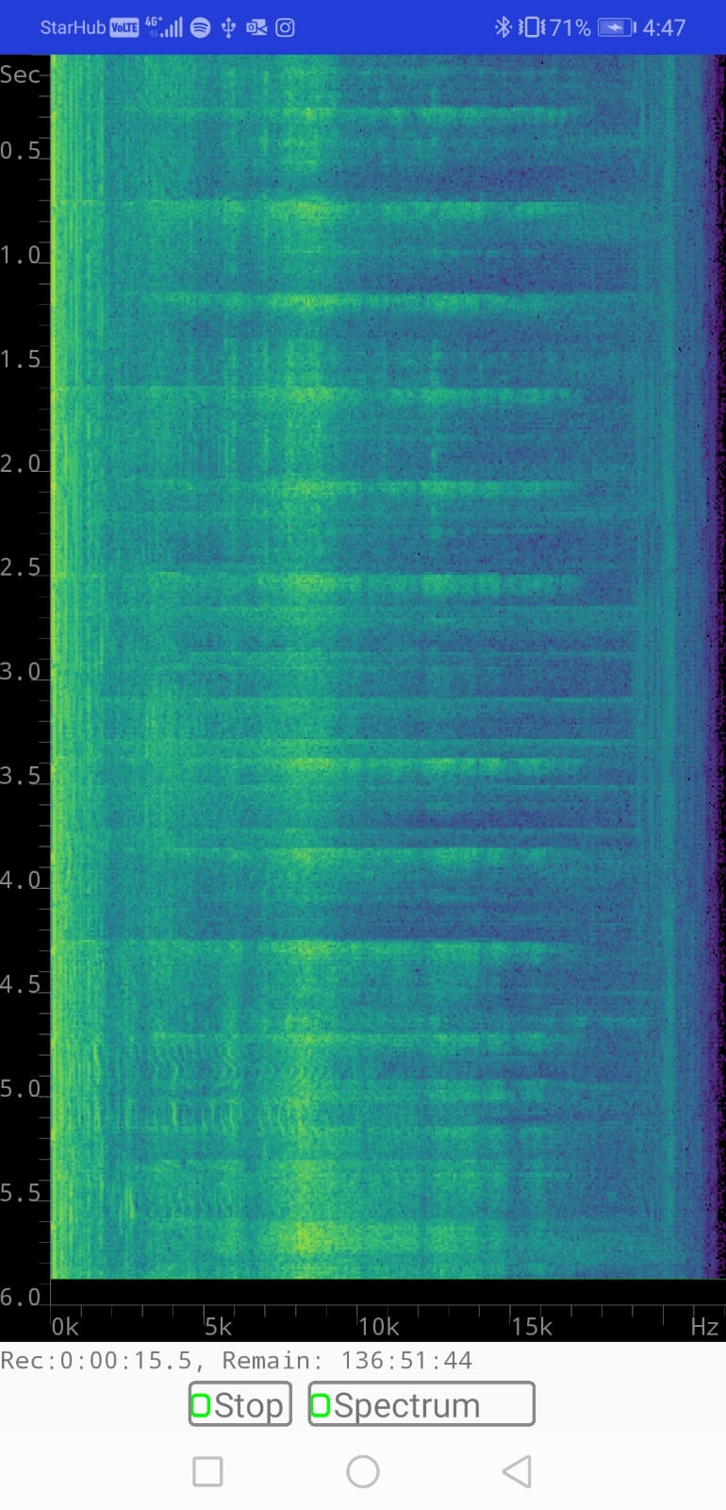
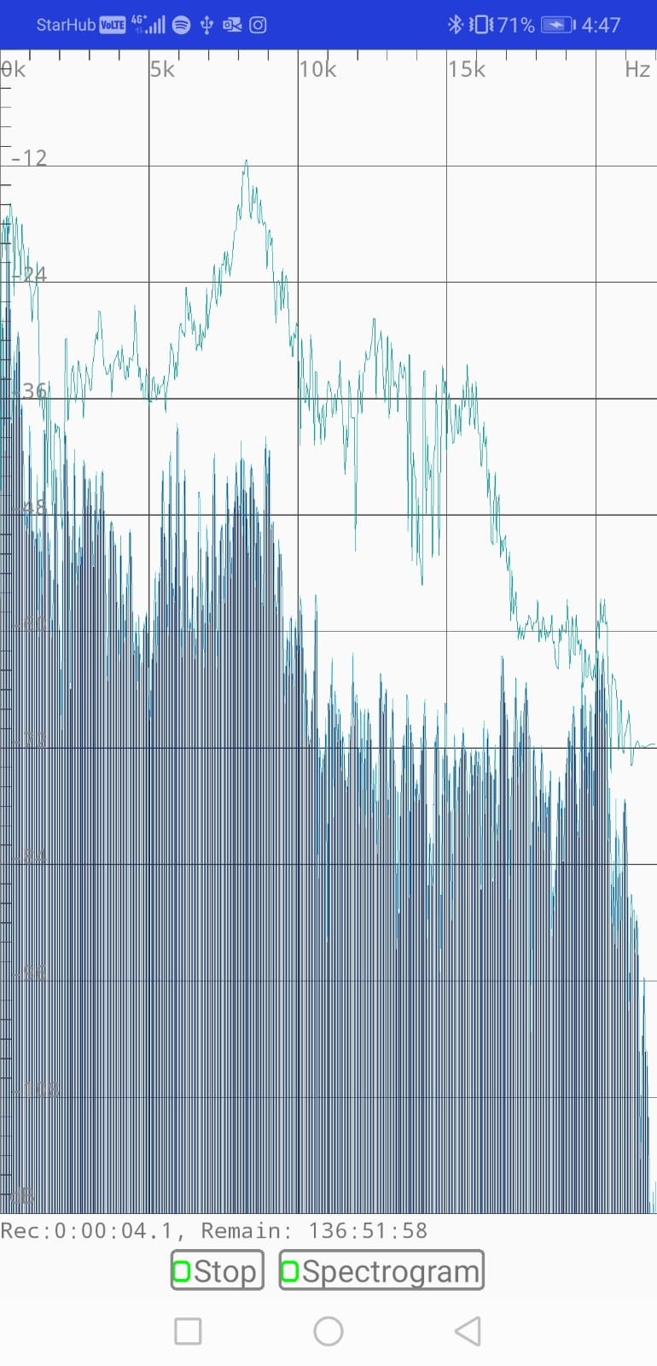
Demonstration

Slide 68
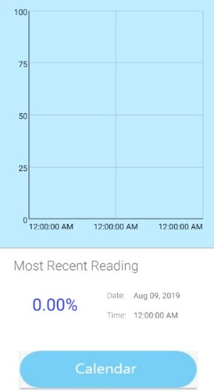

Demonstration

Slide 69

Demonstration

Slide 70

Problems Faced

Slide 71


Time
Hardware

Slide 72
Thank You!

Slide 73
Q & A

